Slide 1


Comparing the neighborhoods in Saint Petersburg and Berlin
Nikita Gorynin,
Saint Petersburg, 2019

Slide 2
Both cities have a status of cultural and educational capitals of their countries and are kind of similar in a lot of ways:
Feature | Saint Petersburg | Berlin
Population, inh | 5 398 064 | 3 363 231
Area, km^2 | 1 441,95 | 888,73
Population density, inh/km^2 | 3 743,59 | 3 784, 31
Number of boroughs | 18 | 12
Number of neighborhoods | 111 | 96
If someone wants to move from one city to another and live in a neighborhood of similar density and similar venues around – what neighborhood will we advice to him?

Slide 3
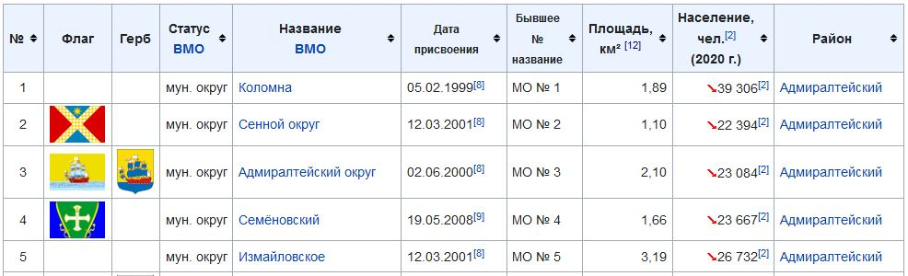
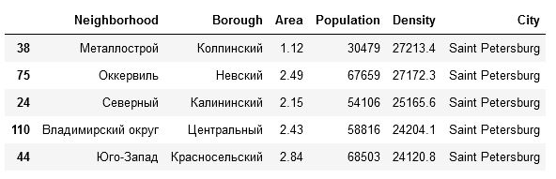
Getting the neighborhood information for both cities from Wikipedia:

Slide 4
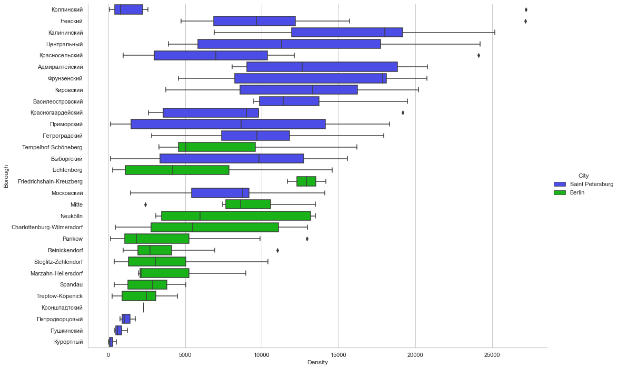
Comparing the neighborhood densities:
Saint Petersburg neighborhoods are mostly denser, than Berlin’s

Slide 5
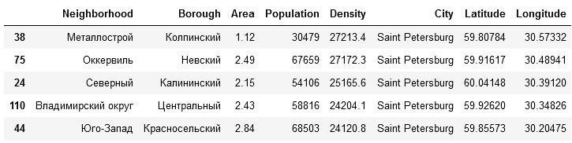
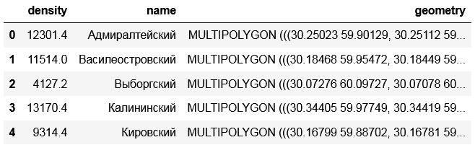
Getting the geographical location for each neighborhood from Arcgis:
Getting the borough boundaries in each city from OpenStreetMaps:

Slide 6
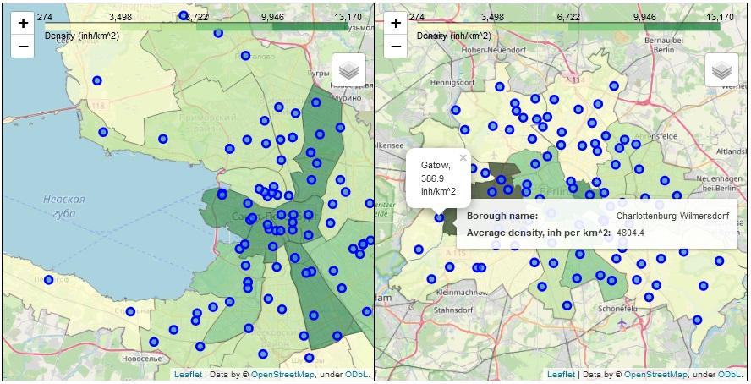
Combining the density and geographical data:

Slide 7
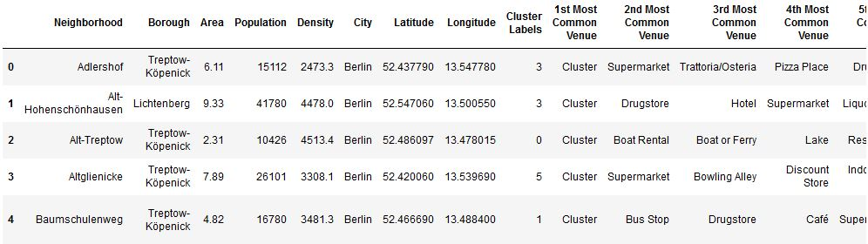
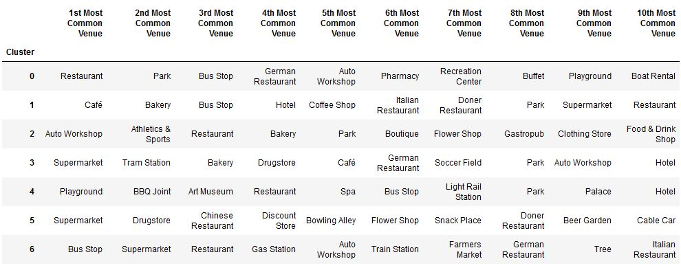
Getting the venue data for each neighborhood using Foursquare API and clustering the
neighborhoods using K means method:

Slide 8
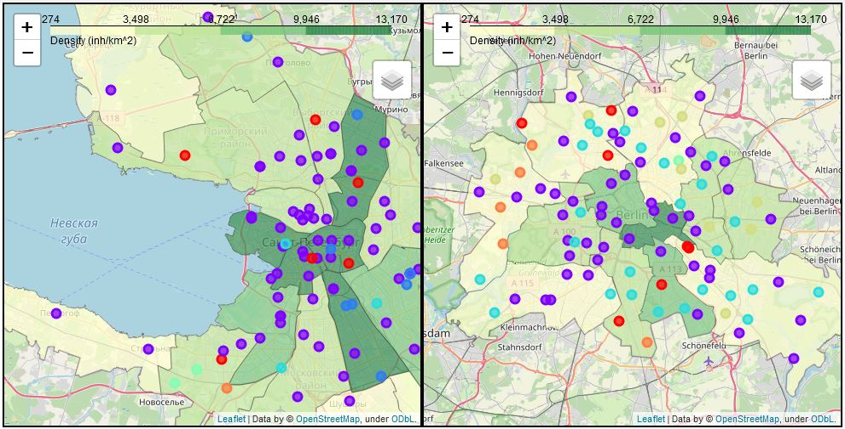
Adding clusters to the map:

Slide 9
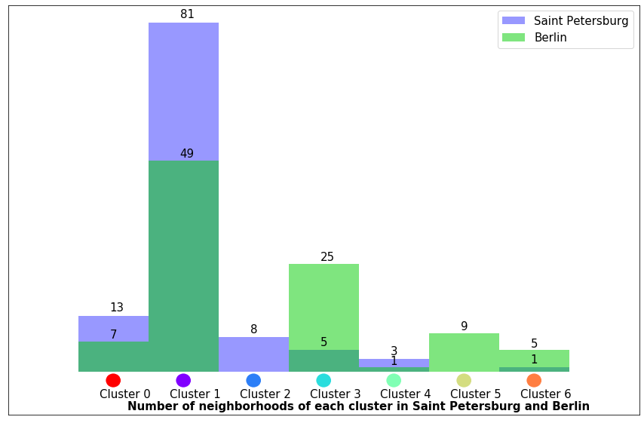
Analysing the clusters:
92.56% of Saint Petersburg inhabitans can find a neighborhood of same cluster in Berlin
91.0% of Berlin inhabitans can find a neighborhood of same cluster in Saint Petersburg:

Slide 10
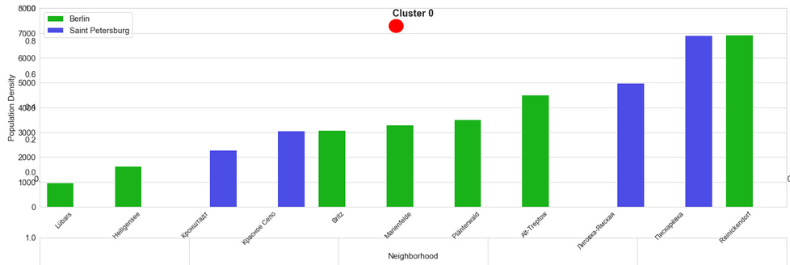
Advising the most similar neighborhoods:
Live here?
Watch this places

Slide 11
Conclusion and remarks:
Advice for people willing to move to another city is provided
Most of inhabitants in each citie can find a similar place in another one
It’s easier to move to a similar place from some kinds of neighborhoods while it’s not possible
for some of them
Restrictions of method and future directions:
As venues were acquired from a circle, centered on a neighborhood, not all neighborhood venues
were analysed
As heatmap was built using borough data, instead of neighborhood, impression of the density
distribution might be distorted
Clustering results depend on number of clusters initialized, thus demanding an additional analysis

